Slide 1
TOY FACTORY
GAME
Professor Harrington
It-516
BY:
Ramprasad battula
Dinesh reddy gopannagari Venkata
Venkata ashok reddy kommireddy
Siva prasad reddy kusam
Sagar reddy yalla

Slide 2
AGENDA
BASIC INTRODUCTION ABOUT JAVA DIGRAPH LOGIC
USAGE OF JAVA DIGRAPH
PROJECT INTRO
LOGIC OF GAME AND DIGRAPH IN GAME USED
SOURCE CODE
STATISTICS OF GAME
CONCLUSION

Slide 3
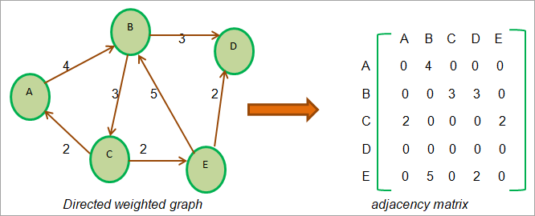
BASIC INTRODUCTION DIGRAPH LOGIC
Digraph
The library "edu.princeton.cs.algs4"
Vertices and edges.
Degree of a Vertex

Slide 4
USage OF DIGRAPH IN JAVA
The main use of a digraph in Java is to represent directed relationships between objects or entities. Some examples of how digraphs can be used in Java include:
Representation
Modeling
Dependencies
Graph Algorithms

Slide 5


PROJECT INTRO

Slide 6
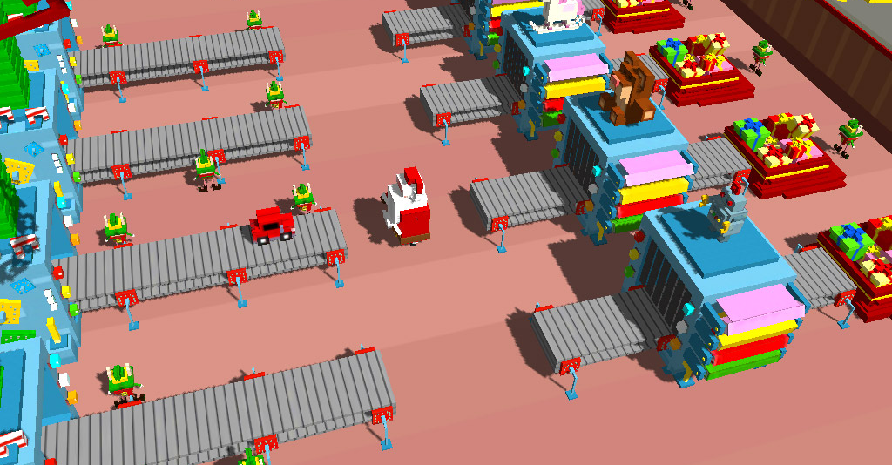
DEMO IMAGE

Slide 7
LOGIC OF GAME AND DIGRAPH IN GAME
Usage of Digraph class in the "edu.princeton.cs.algs4"
Starting game
The game ends when all players run out of fuel or reach the destination.

Slide 8

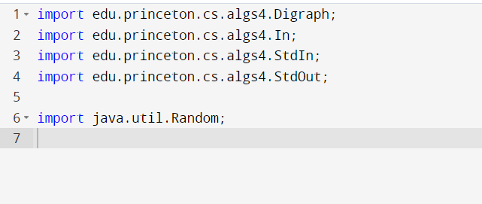
SOURCE CODE EXPLANATION
LIBRARIES

Slide 9
Libraries explanation
The above code imports four classes from the "edu.princeton.cs.algs4" package which is a library of useful data structures and algorithms in Java.
“Digraph” class
"In" class
"StdIn"
"StdOut"
"java.util.Random"

Slide 10
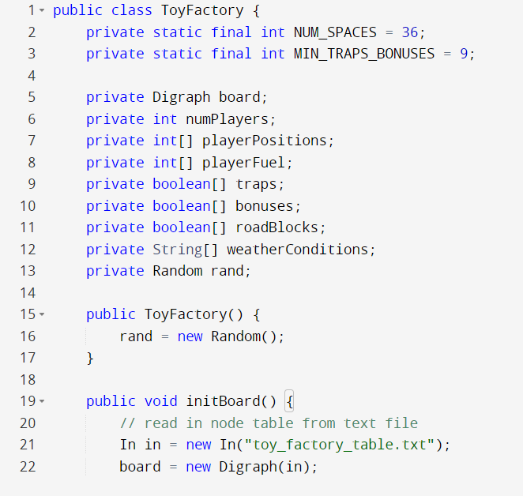
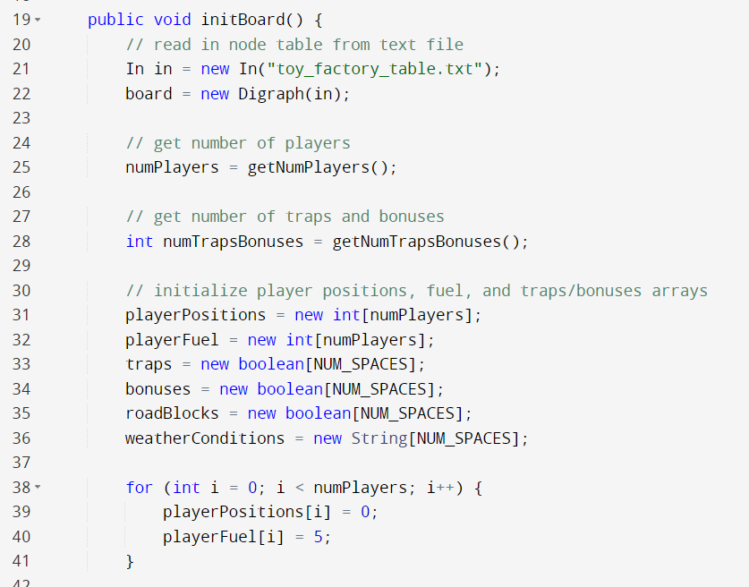
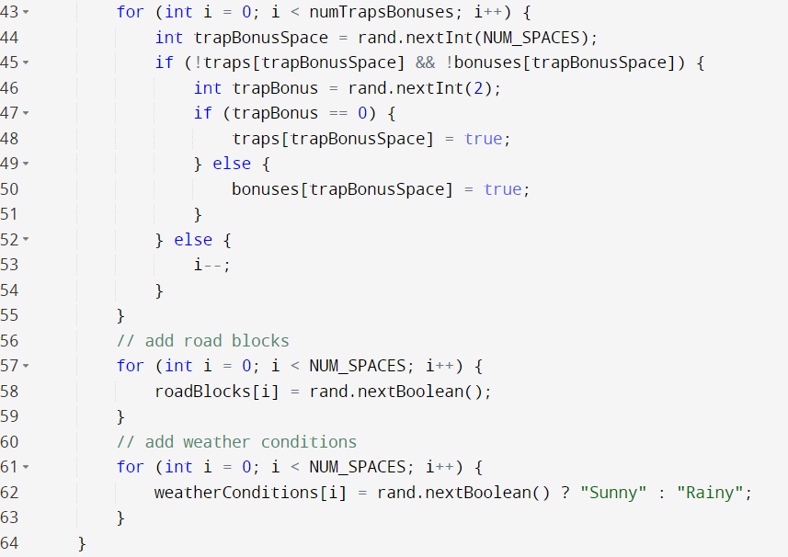
Source code explanation
TOY FACTOR CLASS

Slide 11
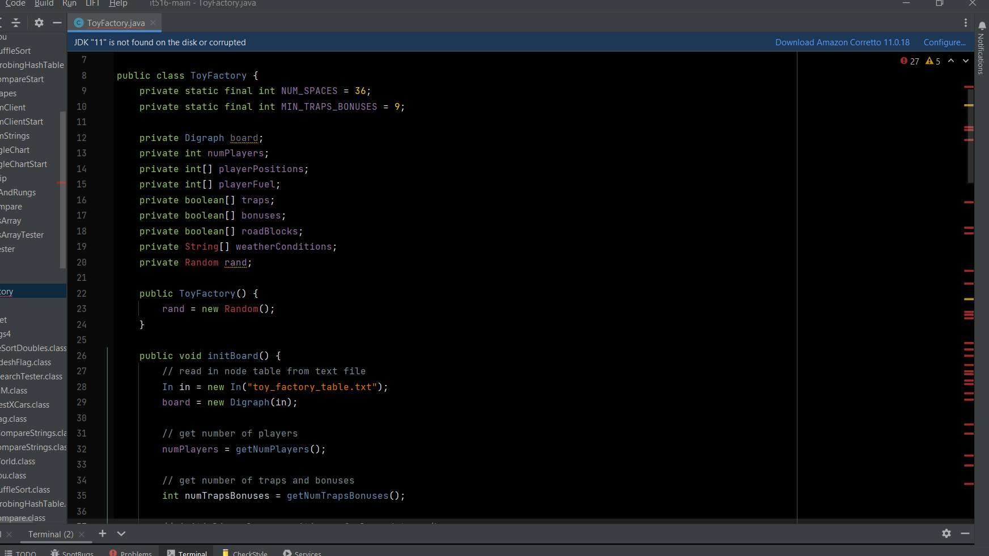
TOY FACTORY CLASS EXPLANATION

Slide 12
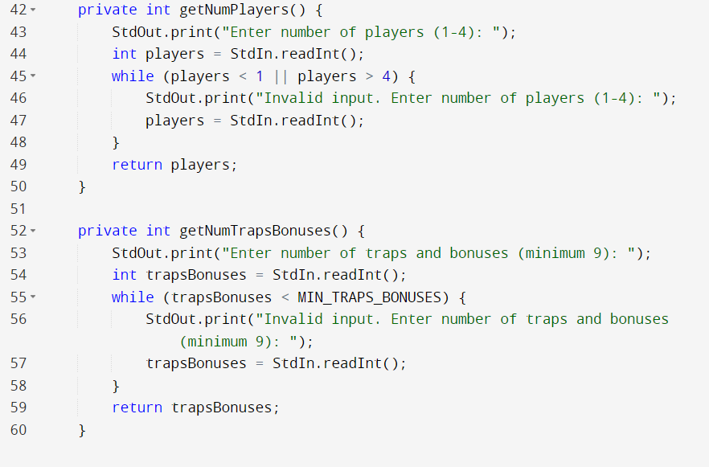
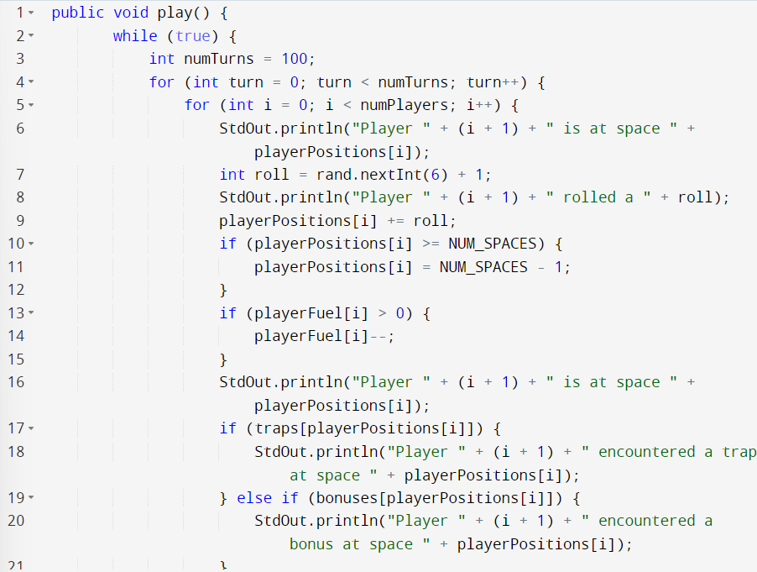
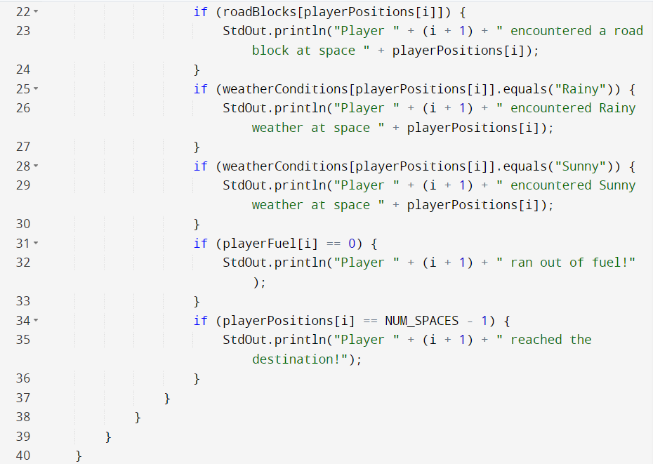
Source code explanation
PLAY, GETNUMPLAYERS, GETNUMTRAPSBONUESES

Slide 13
Play, getnumplayers, getnumtrapbonueses explanation
The getNumPlayers() and getNumTrapsBonuses() methods are helper methods that prompt the user to enter the number of players and the number of traps and bonuses, respectively. The methods validate the input to ensure that the number of players is between 1 and 4, and the number of traps and bonuses is at least 9. These values are later used to initialize the game board.

Slide 14
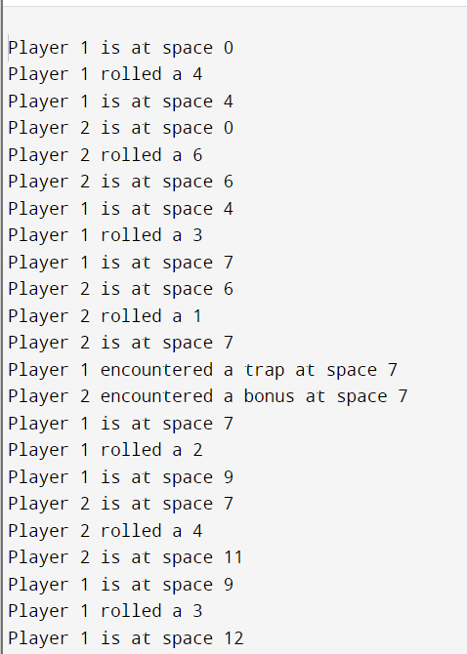
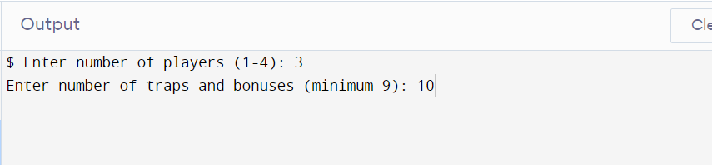
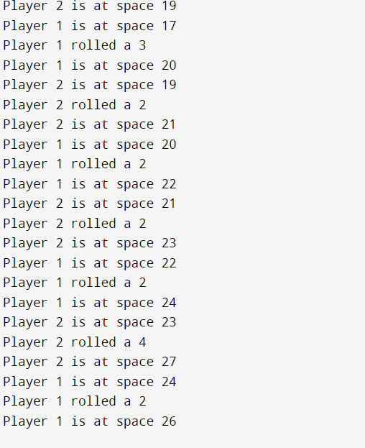
STATISTICS OF GAME (OUTPUT)

Slide 15
conclusion
In conclusion, the toy factory game is a simulation of a board game where players navigate through a factory to reach the end goal. The game uses a digraph data structure to represent the layout of the factory and the movement of the players.

Slide 16
References
Prisner, E. (2014). Game theory : through examples (Ser. Classroom resource materials). Mathematical Association of America. Retrieved January 25, 2023, from INSERT-MISSING-URL.
Chopra, R. (2015). Java programming. New Age International Pvt. Retrieved January 25, 2023, from https://search.ebscohost.com/login.aspx?direct=true&scope=site&db=nlebk&db=nlabk&AN=2706814.
Schildt, H. (2011). Java (8th ed., Vol. , the complete reference /). McGraw-Hill.
Java. (2022). Cabi Compendium, Compendium. https://doi.org/10.1079/cabicompendium.108714
Prudhomme, G. (2020). Java programming applications (E-book). Arcler Press. Retrieved January 25, 2023, from INSERT-MISSING-URL

